Slide 1
Anxiety
Supporting Your Child’s Mental Health
Castlemore PS
February 2016
Notes:
Cassidy

Slide 2

What are your hopes and dreams for your child?
Notes:
Courtesy of: Linda Lantieri
Reflect and think about what you would say
Your one thing
Love, meaning, peace, living with purpose, happiness, joy
Most school systems are not teaching this….this is the paradigm shift inherent in our Board MH Strategy
Education is not a focus on academic/intellect only, these do not need to be at the expense of each other…we need BOTH

Slide 3
“ How can we prepare kids for the tests of life rather than a life of tests?”
Linda Lantieri

Slide 4
Our Task as Parents and Educators
To prepare our children/students to be:
Ready for the post secondary and employment world
Positive contributors to society
Healthy and Thriving

Slide 5
Our Students
“I feel like people won’t value me if I don’t do well at school”
32% Elem 39% Sec
“I usually hide my feelings of anxiety and sadness”
58% Elem 64% Sec
“I feel like I am expected to be perfect ”
46% Elem 54% Sec

Slide 6

What do we mean when we talk about mental health?

Slide 7
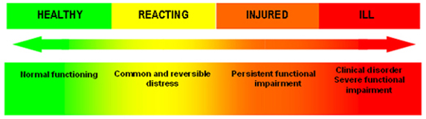
Holistic Approach

Slide 8
Your Brain on Anxiety

Slide 9


Slide 10

What does a stress or anxiety reaction look like?
Thoughts
“Something bad might happen”, “I am not competent”, “I need to be perfect”, “What if..”
Feelings
Worry, tension, fear, unsettled
Behaviors
Avoidance of feared situations, perfectionism, procrastination, inertia, irritability
Sensations
Stomach aches, sweaty palms, shakiness, dizziness, racing heart, shortness of breath, muscle tension
Overestimate the threat and underestimate their ability to cope

Slide 11
Difference between anxiety and fear
Fear
Reaction caused by actual threat of danger or harm
Sensible response to something potentially harmful
Necessary and useful to preserve life
Anxiety
Similar to fear but to events or things that are either not dangerous or are much less harmful than imagined
Feelings come from the anticipation of danger or that something might happen
Dr. Robin Alter
www.docrobin.com
Notes:
CASSIDY

Slide 12
When to be Concerned
How to know if your child is struggling with stress, anxiety, or perfectionism
F requency
I ntensity
D uration
D evelopment
Notes:
Shilagh

Slide 13
When should I worry?
High anxiety
Hesitancy to move outside of the comfort zone
Anxiety based procrastination
Hyper-competitiveness
“All or Nothing” Thinking
Dysregulated affect: high distress for perceived “failures”

Slide 14
Why Does this Happen?
The Power of the Brain
Notes:
Cassidy

Slide 15
Designed to keep our body in balance
Our body craves homeostasis
The brain supports adaptive functioning
It is hardwired to protect us
Often mental health issues are rooted in a neurological pattern
Notes:
Cassidy

Slide 16
Why is this important?
Flight,
Fight,
or
Freeze
Notes:
Cassidy

Slide 17
A Helpful Brain Model
Dr. Daniel Siegel
Notes:
CASSIDY

Slide 18
Our starting place
Negativity Bias
Trauma
Attachment disruption
High expectations (internal or external)

Slide 19
Changing the Brain
We need our brain to have the alarm system, we wouldn’t want to turn if off BUT higher level cortical functions help us moderate it
Plasticity allows us to strengthen how the brain regulates
Pruning gets rid of circuits we don’t use
Notes:
CASSIDY
Negativity bias
Attachment
Startle response

Slide 20
Neither comprehension or learning can take place in an atmosphere of anxiety.
Rose Kennedy
Notes:
CASSIDY

Slide 21
The Significance of Safe Space
To learn students need to feel safe. When students don’t feel safe, the fight or flight center of the brain, the amygdala, fires and incapacitates the hippocampus, the new-learning center of the brain. Students then become survivors vs. learners (Nussbaum, 2012).
Notes:
CASSIDY

Slide 22

How can we help?
Support your child to integrate self care

Slide 23
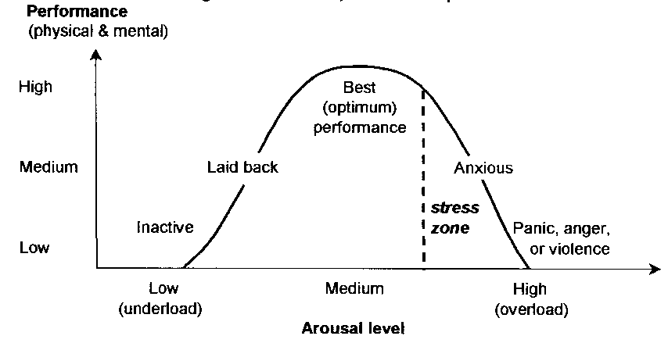
Anxiety Curve

Slide 24
….teach me HOW to calm down don’t just TELL me to…

Slide 25
Understanding the Triad
S.O.S
STOP….OBSERVE….SHIFT
MIND
Thoughts/Feelings
Behaviors
BRAIN/BODY
Physiology

Slide 26
Shifting the Triad: Modifying thoughts
Thoughts/Feelings
Notes:
Shilagh

Slide 27
Taming the Mind
Cognitive reframing
Interrupt the negative pattern
Retrain the pattern
Car analogy—automatic to manual

Slide 28
Shifting the Triad: Modifying Thoughts
Cognitive Behavioral Therapy
Changing thinking (cognition) to influence behavior
Trying to judge perceived threats using a more rational scale or creating an emotional distance from certain fears/beliefs/feelings i.e. putting things in a new, more balanced perspective
Notes:
Shilagh

Slide 29
Cognitive Reframing
Adapted from: D. Bilsker, M. Gilbert, D. Worling & E. J. Garland
Situation | Thoughts Thinking Error | Realistic Thoughts
 | All or Nothing Thinking Overgeneralization Disqualifying the positive Jumping to conclusions | What proof do I have? Would most people agree with this thought? If not, what would be a more realistic thought? What would I say to a friend in a similar situation?

Slide 30

Self Compassion
Not about judging ourselves positively, but a way of relating to ourselves kindly, embracing ourselves lovingly flaws and all

Slide 31
Shifting the Triad: Modifying Physiology
Sensation/Physiology
Notes:
CASSIDY

Slide 32

Strategies: Take up Smoking
Just kidding!
Why this works:
Taking a break physically from place/environment which generates stress
Deep breathing
Let’s practice…
4, 7, 8 Breathing

Slide 33
Modifying Physiology/Sensation
Habituation
A reduction of a person’s physiological response to a repeated specific stimulus
We can change the way we experience a stimulus/stressor/anxiety invoking event by controlled, repeated gradual exposures
Pairing NEGATIVE stimulus with a POSITIVE stimulus to retrain the brain
Analogy: cold lake
Notes:
CASSIDY
Diving into a cold lake
Shock to the system
What you might have experienced is that it is often worse/more painful sitting on the dock
Once you are in—habituate to the environment…process of toe dip and respond, process of jumping in…outcome is the same REWARD THE EFFORT NOT SUCCESS, APPROXIMATIONS are PROGRESS

Slide 34
Shifting the Triad: Modifying Behaviour
Behaviour
Notes:
Shilagh

Slide 35
Mindfulness
A seated meditation may be easiest OR a body scan
Seated Body Scan
MARC.ucla (Mindfulness Awareness Resource Centre) meditation recordings iTunes U
Guided Mindfulness
(free audio guided meditations)

Slide 36
Modifying Actions
Cycle of Avoidance/Escape
This is the behavior that follows thoughts and sensations of anxiety/depression
Understandable as it relieves the “pressure”
Difficult to break but important to move towards new ways of responding (face it to erase it!)
Small, measured steps in confronting this (exposure hierarchy)
It will be hard to see a student in distress, be prepared—you staying calm and moving forward is reassuring, sends the message there is nothing to fear
Analogy-learning to ride a bike
Notes:
So hard to let go but it is needed for the child to overcome the fear of falling
If you never let go they never feel the success of overcoming the fear

Slide 37
Quit hits to support brain health…
The Joy List
The Random Act of Kindness
The Strengths List
The Savoring
The Social Support Squad
Daily Gratitude
Adapted from: http://anxietyfreechild.com/positive-psychology-guide/

Slide 38
Be cautious
Getting too enthusiastic when a spark of progress has been made can project an energy
This energy can overwhelm the student and put their brain back into “alarm”—fight, flight or freeze
Notes:
Shilagh

Slide 39
Your role in supporting your child
Practice stress reduction with your child
Celebrate ALL aspects of your child—character, personality, school, work etc.
Deliver messages of self compassion
Get help if you feel their/your stress level is impacting you in ways you cannot manage
Notes:
Stress becomes a problem when you feel overwhelmed by the things that happen to you. You may feel “stressed out” when it seems there is too much to deal with all at once, and you are not sure how to handle it all.
When you feel stressed, you usually have some physical symptoms. You can feel tired, get headaches, stomach upsets or backaches, clench your jaw or grind your teeth, develop skin rashes, have recurring colds or flu, have muscle spasms or nervous twitches, or have problems sleeping.
Mental signs of stress include feeling pressured, having difficulty concentrating, being forgetful and having trouble making decisions.
Emotional signs include feeling angry, frustrated, tense, anxious, or more aggressive than usual.

Slide 40
If the day ever came when we were able to accept ourselves and our children exactly as we are and they are, then, I believe we would have come to an understanding of what "good parenting" means.
Fred Rogers

Slide 41
Are you ready to change the lens?
http://www.ted.com/talks/shawn_achor_the_happy_secret_to_better_work?language=en

Slide 42
The 21 day Challenge
Daily:
Write down 3 new things you were grateful for that day
Journal one positive experience
Exercise
Meditation
One random act of kindness

Slide 43
Resources
Websites:
Parents for Children's Mental Health
Anxiety BC
Anxiety BC Parent Toolkit
Mind Your Mind
Books:
Building Emotional Intelligence (Linda Lantieri)
Flourish (Dr. Seligman)
The Mindful Child (Susan Kaiser Greenland)
Brainstorm: The Power and Purpose of the Teenage Brain (Daniel Siegal)
The Highly Sensitive Child: Helping Our Children Thrive When the World Overwhelms Them (Elaine Aron)
Keys to Parenting Your Anxious Child, (Dr. Katharina Manassis)
Worried No More, Second Edition: Help and Hope for Anxious Children (Aureen Wagner)
Freeing Your Child From Anxiety, (Tamar Chansky)
Helping Your Anxious Child (Ronald M. Rapee)

Slide 44
Questions?

